Slide 1
DBMS Project — IILM University
E-Learning
eLearning
Platform
STUDENT • FACULTY • COURSE
ENROLLMENT • ASSIGNMENT
ER Diagram & Database Design
Submitted To:
Submitted By:
Database Management System
Mr. Atul Singh

Slide 2
What is an E-Learning Platform?
Definition
Why DBMS?
Core Objectives
An E-Learning Platform is a relational database-driven solution designed to store, manage, and track all academic operations — from student registrations to assignment submissions.
Reduces manual work, improves accuracy, consistency, and data security using structured relational tables, primary/foreign keys, and an ER model.
Manage students, faculty, courses, enrollments, assignments, and submissions — all linked through defined relational constraints.

Slide 3
Entity Description
Six core entities form the backbone of the system, each with a primary key and defined attributes.
1
STUDENT
2
FACULTY
Student_id (PK), First Name, Middle Name, Last Name, Phone No, Student_Email, Registration_date
Faculty_id (PK), Faculty_Name, Faculty_Email, Faculty_Qualification, Faculty_exp
3
COURSE
4
ENROLLMENT
course_id (PK), Course_name, Credits, Description
En_id (PK), student_id (FK), Course_id (FK), Enrollment_date
5
ASSIGNMENT
6
SUBMISSION
Assignment_id (PK), Tittle_Des, Due_Date, Course_id (FK)
Submission_id (PK), Assignment_id (FK), Student_id (FK), Submission_date, Marks

Slide 4
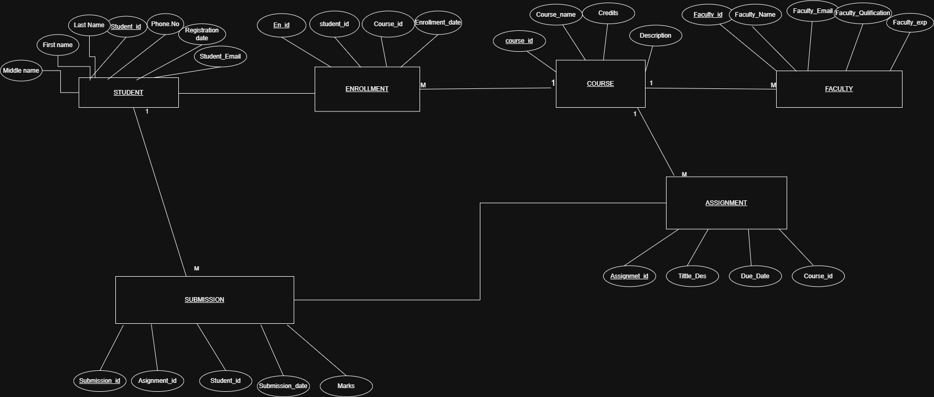
ER Diagram
Entity-Relationship diagram illustrating all six entities, their attributes, and relationships with cardinality constraints.
Student_id
Phone.No
Credits
ER Model Relationships
course_id
STUDENT
COURSE
STUDENT → ENROLLMENT
1
1
1
1:M (one student, many enrollments)
M
M
M
ENROLLMENT → COURSE
ENROLLMENT
1
FACULTY
M:1 (many enrollments per course)
COURSE → FACULTY
1
1:M (one course, many faculty)
ASSIGNMENT
M
COURSE → ASSIGNMENT
Assignmet_id
Due_Date
1:M (one course, many assignments)
SUBMISSION
STUDENT → SUBMISSION
M
1
M
1:M (one student, many submissions)
Submission_id
ASSIGNMENT → SUBMISSION
Marks
1:M (one assignment, many submissions)

Slide 5
Relational Schema & Keys
Relational Schema
Foreign Key Constraints
STUDENT (student_id, first_name, middle_name, last_name, phone_no, student_email, registration_date)
enrollment.student_id → student.student_id
enrollment.course_id → course.course_id
assignment.course_id → course.course_id
submission.assignment_id → assignment.assignment_id
submission.student_id → student.student_id
FACULTY (faculty_id, faculty_name, faculty_email, faculty_qualification, faculty_exp)
COURSE (course_id, course_name, credits, description)
ENROLLMENT (en_id, student_id, course_id, enrollment_date)
Primary Keys
ASSIGNMENT (assignment_id, tittle_des, due_date, course_id)
student_id · faculty_id · course_id
en_id · assignment_id · submission_id
SUBMISSION (submission_id, assignment_id, student_id, submission_date, marks)

Slide 6
System Workflow, DB Operations & Normalization
System Workflow
1NF
Atomic values, no repeating groups
Student registers → Course enrolled → Faculty assigned → Assignment created → Student submits → Marks recorded.
2NF
No partial dependencies on composite keys
Database Operations
Supports full CRUD operations — Create, Read, Update, Delete — across all six entities.
3NF
No transitive dependencies; full referential integrity

Slide 7
Conclusion
The E-Learning Platform delivers an efficient, structured approach to managing academic data using a relational DBMS.
Data Integrity
Efficiency
Scalability
Enforced via primary and foreign key constraints across all six entities.
Reduces manual errors and streamlines academic workflows end-to-end.
Normalized schema supports future expansion — quizzes, grades, notifications — with minimal restructuring.

